Slide 1



NIR calibrations

Slide 2
Corn Silage
NIR ID# 1
Maize silage (Zea mays L.) is made out of whole ensiled maize plants. It is one of the most valuable forages for ruminant livestock and it is used wherever maize can grow, from temperate regions to the tropics. The popularity of maize silage is due to several factors. It is a consistent source of palatable and high-energy forage for all classes of ruminants, including dairy cattle, beef cattle, sheep and goats
 | DM | Starch | C.Protein | ADF | NDF | Ash | C.Fat
MIN | 20.1 | 18.1 | 3.1 | 14.7 | 27.1 | 1.8 | 1.9
MAX | 53.4 | 46.4 | 10.0 | 40.0 | 68.5 | 7.5 | 4.2
Average | 35.4 | 31.1 | 7.3 | 23.6 | 41.8 | 4.1 | 3.0
SD | 5.1 | 5.5 | 0.8 | 3.3 | 5.4 | 0.8 | 0.4
N.Samples | 573 | 529 | 538 | 538 | 528 | 538 | 538
*Dry Matter base

Slide 3
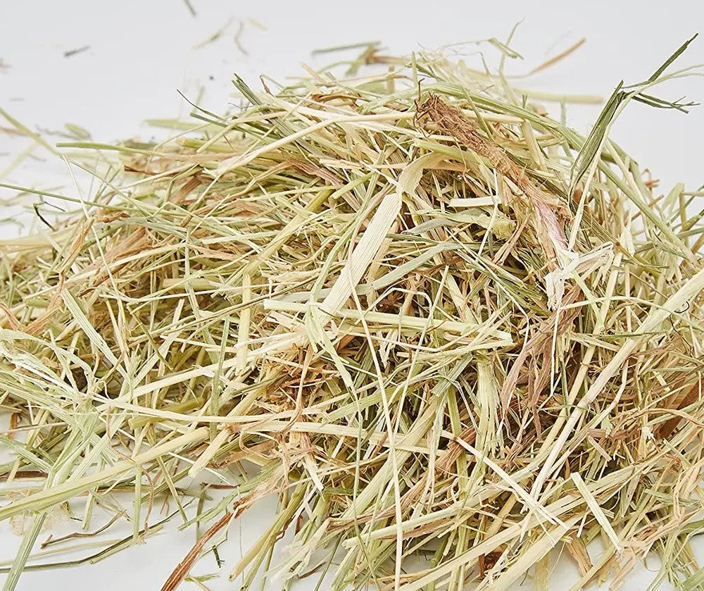
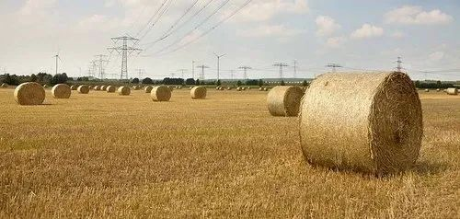
Dry Grass Hay
NIR ID# 2
Hay is grass, legumes, or other herbaceous plants that have been cut and dried to be stored for use as animal fodder
Calibration includes mixtures of grasses such as ryegrass (Lolium species),
timothy, brome, fescue, Bermuda grass, orchard grass, and other species.
 | DM | Starch | C.Protein | ADF | NDF | Ash | C.Fat
MIN | 73.1 |  | 3.0 | 20.7 | 41.5 | 2.4 | 0.3
MAX | 97.5 |  | 21.0 | 61.1 | 79.1 | 15.5 | 3.0
Average | 90.4 |  | 10.0 | 36.0 | 61.1 | 7.9 | 1.5
SD | 3.1 |  | 3.9 | 7.2 | 8.6 | 1.6 | 0.6
N.Samples | 318 |  | 318 | 318 | 318 | 318 | 318
*Dry Matter base

Slide 4
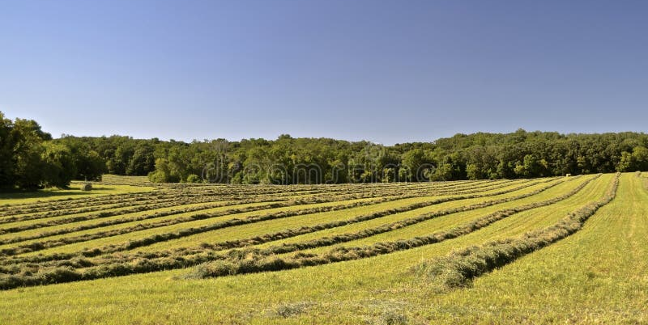
Dry Alfalfa Hay
NIR ID# 4
Alfalfa (Medicago sativa L.) is a perennial herbaceous legume. Due to its high nutritional quality, high yields and high adaptability, alfalfa is one of the most important legume forages of the world. A major source of protein for livestock, it is a basic component in rations for dairy cattle, beef cattle, horses, sheep, goats and other classes of domestic animals
 | DM | Starch | C.Protein | ADF | NDF | Ash | C.Fat
MIN | 73.2 |  | 4.4 | 20.2 | 25.6 | 3.1 | 0.5
MAX | 96.4 |  | 25.2 | 56.3 | 72.1 | 20.8 | 3.0
Average | 89.6 |  | 16.6 | 36.5 | 49.9 | 9.0 | 1.7
SD | 3.4 |  | 3.9 | 5.8 | 8.4 | 2.3 | 0.5
N.Samples | 423 |  | 425 | 424 | 425 | 416 | 416
*Dry Matter base

Slide 5
Green Maize
NIR ID# 15
Maize (Zea mays L.) green forage, particularly when it contains the stalks, leaves and ears, is an energy-rich feed for ruminant livestock. While maize forage is usually ensiled in cooler regions, year-round maize production in the tropics may allow the continuous harvesting of green forage, making ensiling unnecessaryGrazing whole maize plants also provides green fodder to livestock in periods of scarcity (dry and hot summers, and winters).
 | DM | Starch | C.Protein | ADF | NDF | Ash | C.Fat
MIN | 18.5 | 0.7 | 4.3 | 14.9 | 28.4 | 2.2 | 1.3
MAX | 68.6 | 48.3 | 11.2 | 34.6 | 59.5 | 8.6 | 3.9
Average | 34.0 | 27.1 | 7.4 | 26.0 | 43.2 | 4.1 | 2.7
SD | 7.2 | 7.0 | 1.4 | 3.5 | 5.4 | 1.1 | 0.5
N.Samples | 343 | 238 | 238 | 179 | 240 | 241 | 178
*Dry Matter base

Slide 6
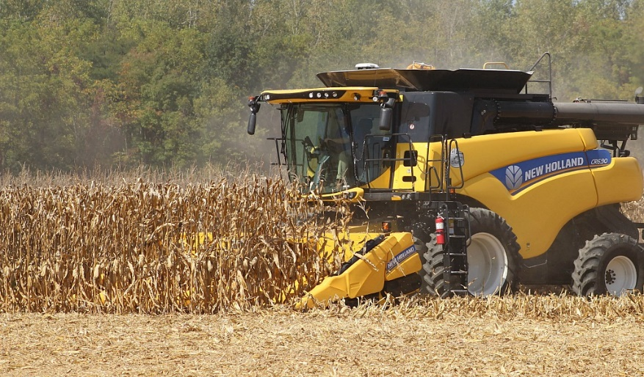
Corn Grain
NIR ID# 8
Maize (Zea mays L.) is a major staple food grain throughout the world, particularly in Africa, Latin America and Asia, and a major feedstuff in developed countries. The maize grain has many food (grain, flour, syrup, oil…) and non-food usages (cosmetics, adhesives, paints, varnishes). Maize starch and oil are also major products. The maize grain is a major feed grain and a standard component of livestock diets where it is used as a source of energy. Other grains are typically compared to maize when their nutritional value is estimated.
 | DM | Starch | C.Protein | ADF | NDF | Ash | C.Fat
MIN | 64.2 | 67.6 | 7.2 |  | 6.9 | 1.0 | 2.9
MAX | 89.7 | 75.7 | 11.4 |  | 12.4 | 2.2 | 5.4
Average | 83.6 | 72.2 | 8.7 |  | 9.5 | 1.5 | 3.9
SD | 4.4 | 1.4 | 0.7 |  | 1.1 | 0.3 | 0.4
N.Samples | 173 | 172 | 209 |  | 0 | 206 | 214
*Dry Matter base

Slide 7
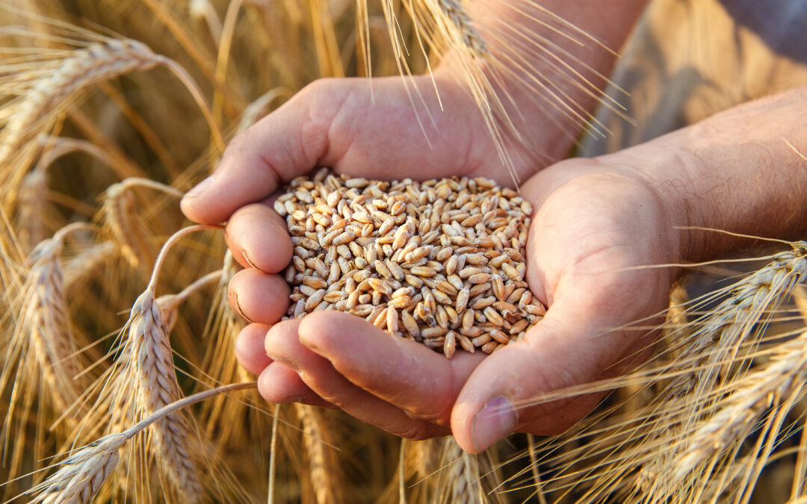
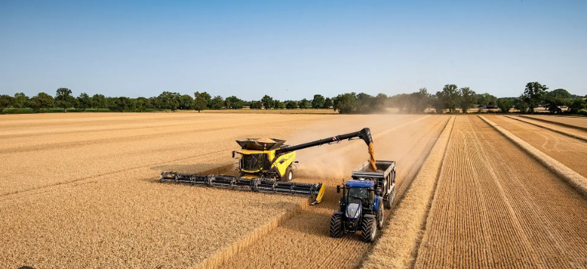
Wheat Grain
NIR ID# 9
Wheat grain (Triticum spp.) is a major staple food that provides about 20% of food energy and protein worldwide. Wheat is also an excellent energy source for farm animals: in 2007, 102 million tons (16.7% of worldwide production) were used to feed animals. This proportion is higher in industrialised countries: in the EU-27 in 2007, 42% of wheat production was used as feed (FAO, 2011). Feed wheat is often surplus to human requirements or low-quality wheat unsuitable for human consumption (low test weight or damaged wheat), but wheat is also grown specifically for feed purposes (Blair, 2008; Lalman et al., 2011).
 | DM | Starch | C.Protein | ADF | NDF | Ash | C.Fat
MIN | 80.4 | 60.1 | 9.2 |  | 2.2 | 2.2 | 1.1
MAX | 91.4 | 69.1 | 21.2 |  | 3.2 | 3.2 | 2.2
Average | 87.6 | 65.2 | 13.5 |  | 2.7 | 2.7 | 1.7
SD | 2.1 | 1.7 | 2.1 |  | 0.2 | 0.2 | 0.2
N.Samples | 255 | 252 | 246 |  | 78 | 181 | 243
*Dry Matter base

Slide 8

Barley Grain
NIR ID# 25
Barley (Hordeum vulgare L.) is one of the main cereal crops. With 150 million tons produced in 2009, barley grain production ranked fourth behind maize, rice and wheat (FAO, 2011). Developing countries account for about 25% of the total barley harvested area (Akar et al., 2003).
 | DM | Starch | C.Protein | ADF | NDF | Ash | C.Fat
MIN | 83.2 | 47.1 | 8.3 | 5.5 | 16.3 | 2.7 | 1.7
MAX | 90.8 | 59.8 | 15.9 | 8.5 | 24.1 | 3.2 | 2.7
Average | 87.9 | 55.0 | 10.9 | 6.9 | 18.7 | 2.9 | 2.1
SD | 1.3 | 2.4 | 1.6 | 0.7 | 1.2 | 0.1 | 0.1
N.Samples | 190 | 131 | 98 | 69 | 63 | 85 | 91
*Dry Matter base

Slide 9
Soybean Grain
NIR ID# 59
Soybean (Glycine max (L.) Merr.) is the largest oilseed crop, with 276 million t produced in 2013, the main producers being the USA, Brazil, Argentina and China. The value of the crop is partly driven by the demand for soybean meal, which is the by-product of oil extraction, one of the major feed commodities (172 million t used worldwide in 2011) and the main protein source in many animal diets (FAO, 2015). Whole soybean seeds, usually called soybeans or full-fat soybeans to differentiate them from soybean meal, are also used for animal feeding.
 | DM | Starch | C.Protein | ADF | NDF | Ash | C.Fat
MIN | 73.0 |  | 34.1 | 7.4 | 9.2 | 4.4 | 19.4
MAX | 92.4 |  | 55.8 | 10.2 | 12.3 | 8.0 | 28.3
Average | 87.3 |  | 40.4 | 8.6 | 10.3 | 5.7 | 23.2
SD | 3.7 |  | 3.4 | 0.7 | 0.9 | 0.7 | 1.9
N.Samples | 63 |  | 59 | 14 | 13 | 57 | 60
*Dry Matter base

Slide 10
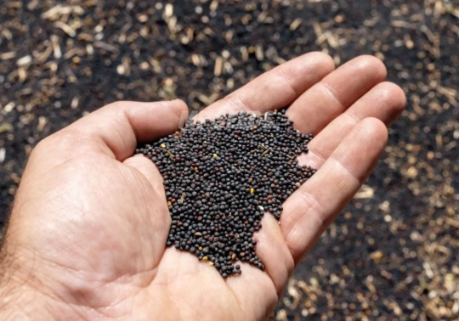
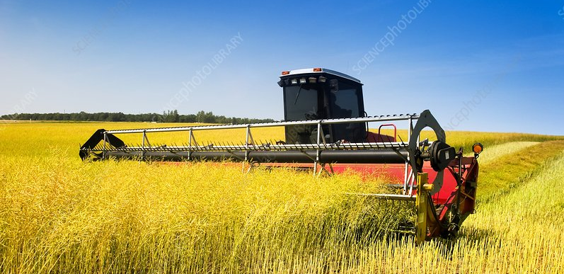
Rapeseed Grain
NIR ID# 143
Rapeseeds - called canola seeds in North America and other countries - are the seeds of the oilseed rape plant. Rapeseeds are the 3rd source of both vegetable oil (after soybean and oil palm) and oil meal (after soybean and cotton). They are the most widely cultivated crop species in the Brassicaceae family, which also includes cabbages, mustards, turnips, radishes and cauliflowers. Modern rapeseed varieties with low concentrations in erucic acid and glucosinolates are mainly used for edible oil, biofuel, industrial oil and lubricants. Rapeseeds are also a valuable energy feed for livestock due to their high protein and lipid content.
 | DM | Starch | C.Protein | ADF | NDF | Ash | C.Fat
MIN | 89.8 |  | 15.3 | 9.3 | 12.4 | 4.0 | 42.2
MAX | 94.0 |  | 24.2 | 12.8 | 15.4 | 4.3 | 52.4
Average | 92.4 |  | 19.5 | 11.3 | 14.2 | 4.1 | 48.3
SD | 1.0 |  | 1.8 | 1.4 | 1.1 | 0.1 | 1.9
N.Samples | 95 |  | 98 | 8 | 8 | 8 | 86
*Dry Matter base

Slide 11
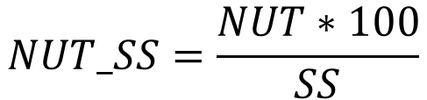
LEGENDA NUTRIENTI
Sigla Italiano | Nome Inglese | Descrizione
SS | Dry Matter (DM) | Sostanza secca
AMIDO | Starch | Amido, se espresso sul DM base -> AMIDO_SS
PG | Crude Protein | Proteina Grezza, se espressa sul DM base --> PG_SS
ADF | ADF | Fibra Acido Detersa, se espressa su DM base --> ADF_SS
NDF | NDF | Fibra Neutro Detersa, se espressa su DM base --> NDF_SS
CEN | Ash | Ceneri, se espresse su DM base --> CEN_SS
EE | Crude Fat | Estratto Etereo, se espresso su DM base --> EE_SS
Formula per il passaggio da nutriente espresso AS IS BASE a nutriente espresso su base DM
$$NUT_SS=\frac{NUT∗100}{SS}$$

Slide 12
BANDE LEGATE AI NUTRIENTI
Nutrient | NIR Region (700–2500 nm) | Less Significant Bands | Characteristic Features
Dry Matter (DM) | 1400–1450 nm (O–H stretch), 1900–1950 nm (O–H bend) | 850–900 nm (moisture content), 970–980 nm (free water modes) | Reflects moisture content and total solids.
Starch | 900–950 nm (C–H overtone), 1200–1250 nm (C–H stretch), 1700–1750 nm (C–H and O–H combinations) | 2100–2150 nm (starch-specific features), 1800–1900 nm (minor carbohydrate signals) | Represents energy availability.
Protein | 2050–2250 nm (N–H combinations), 1500–1550 nm (amide bonds) | 1800–1900 nm (minor amide bands), 1200–1300 nm (aromatic N-H interactions) | Reflects forage nitrogen content.
Fibers (Neutral/Acid Detergent) | 1200–1300 nm (C–H stretch), 1700–1750 nm (O–H and C–H combinations), 2100–2200 nm (C–O and C–H) | 1800–1850 nm (cellulose and lignin features), 1500–1600 nm (hemicellulose interactions) | Indicates cellulose and hemicellulose content.
Fat (Ether Extract) | 1700–1750 nm (C=O and C–H), 2300–2350 nm (C–H aliphatic stretch) | 1500–1600 nm (lipid-specific overtone) | Reflects lipid content.
Ash (Minerals) | 2200–2300 nm (metal–oxygen bonds) | 1400–1450 nm (trace minerals) | Indicates essential mineral content.

Slide 13
www.dinamicagenerale.com

